Slide 1

The History of UX Research

Slide 2

Overview
Industrial Psychology & Scientific Management (Late 19th–Early 20th Century)
Foundations in Ergonomics & Human Factors (1940s–1960s)
Advent of Human–Computer Interaction (1970s–1980s)
Institutionalization of Usability Testing (1980s–1990s)
Broadening of Methods & Contextual Research (1990s–2000s)
Modern UX Research: Digital, Agile & Data-Driven (2010s–Present)

Slide 3
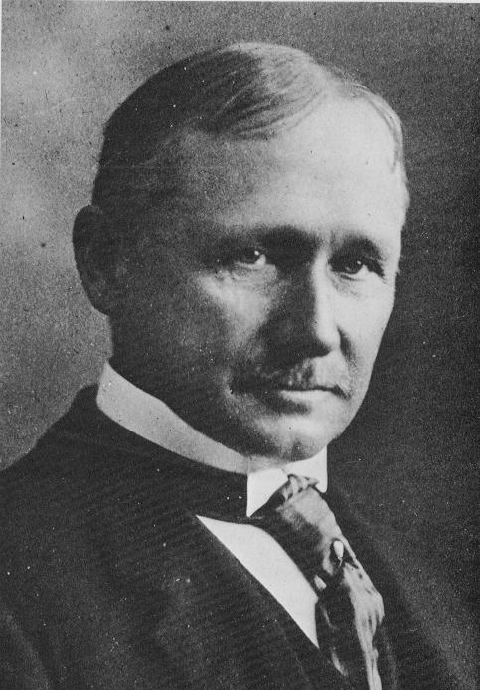
Taylor and Scientific Management
Born: March 20, 1856, Germantown, Philadelphia
Died: March 21, 1915
Excelled academically
Planned to attend Harvard Law School but deteriorating eyesight (?) changed his career path
Notes:
Taylor's family background instilled a strong work ethic in him, and his education at Phillips Exeter Academy laid the foundation for his analytical skills. Although he initially planned to pursue law, his eyesight issues redirected him towards a more practical career in the industrial field. The eyesight issue may or may not have been the real reason for his departure.

Slide 4

Taylor and Scientific Management
Began as a machinist in 1874 at Midvale Steel Works
Quickly rose to the position of chief engineer
Noticed inefficiencies and inconsistencies in work processes
Notes:
Taylor's apprenticeship provided him with essential hands-on experience in the mechanical field, which was crucial for his later work. At Midvale Steel Works, he demonstrated his potential by rapidly advancing to the role of chief engineer, where he began to observe and address inefficiencies in work processes.

Slide 5

Taylor and Scientific Management
Key Innovations:
Detailed time and motion studies
Standardized tasks into smaller components
Scientific selection and training of workers
Principles of Scientific Management Published in 1911
Notes:
Taylor's apprenticeship provided him with essential hands-on experience in the mechanical field, which was crucial for his later work. At Midvale Steel Works, he demonstrated his potential by rapidly advancing to the role of chief engineer, where he began to observe and address inefficiencies in work processes.

Slide 6

Taylor and Scientific Management
Industrial Impact:
Widely adopted in various industries
Transformed productivity and efficiency practices
Criticism:
Viewed as dehumanizing workers
Treated workers as cogs in a machine
“In the past the man has been first; in the future the system must be first.” ― Frederick Winslow Taylor, The Principles of Scientific Management
Notes:
Taylor's methods had a profound impact on the industrial world, with many industries adopting his principles to boost productivity. However, his approach also faced criticism for dehumanizing workers and reducing them to mere components in a machine-like system. This controversy highlighted the need for balancing efficiency with worker well-being.

Slide 7

Taylor and Scientific Management
Replace rule-of-thumb work methods with methods based on a scientific study of the tasks.
Scientifically select, train, and develop each employee rather than passively leaving them to train themselves.
Provide "Detailed instruction and supervision of each worker in the performance of that worker's discrete task"
Divide work nearly equally between managers and workers, so that the managers apply scientific management principles to planning the work and the workers actually performing the tasks.

Slide 8
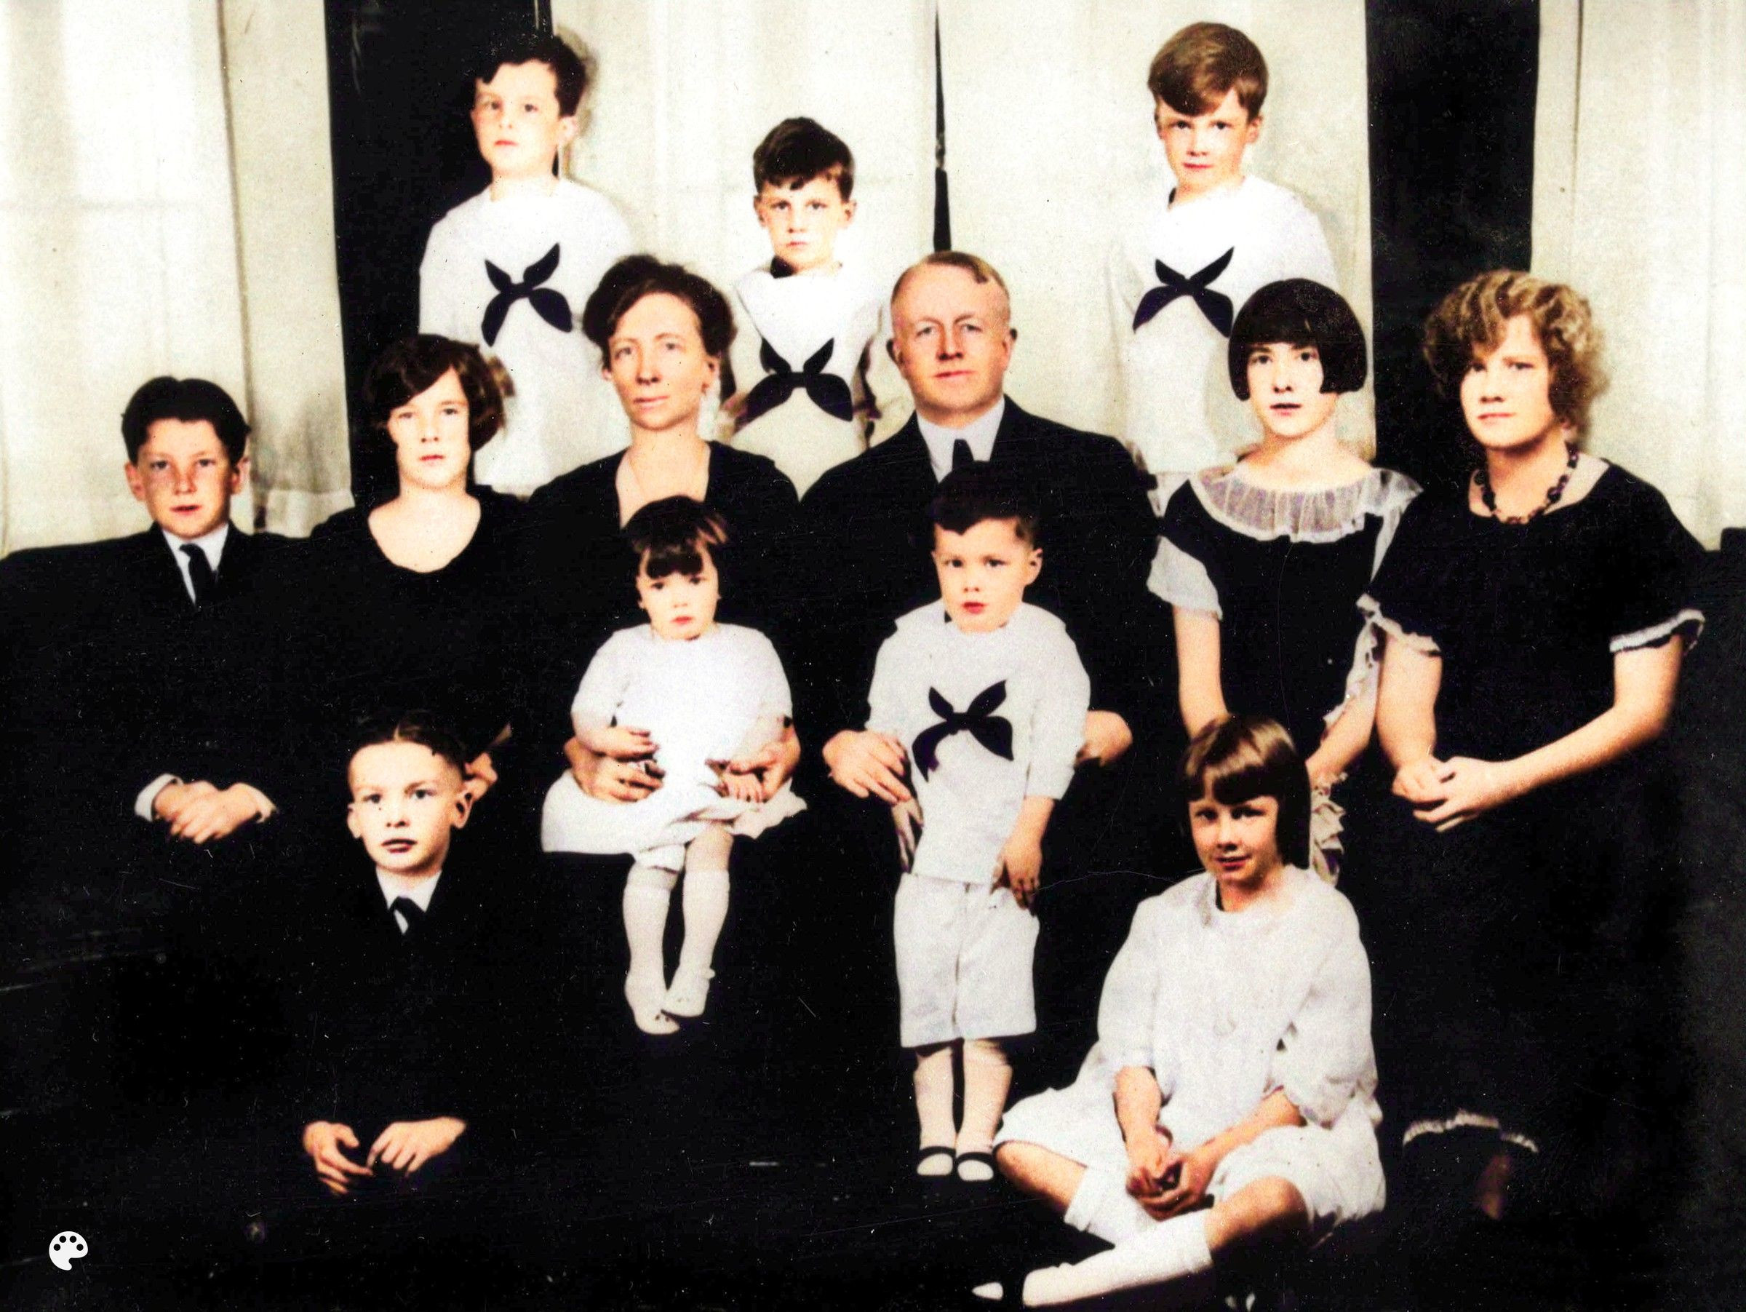
Frank & Lillian Gilbreth (1910s-1920s)
Family fictionalized in Cheaper by the Dozen
Introduced motion analysis and elemental motions they called “Therbligs”
Filmed workers to analyze motions in detail
Emphasized efficiency + worker comfort
Applied techniques beyond factories (e.g., kitchens)

Slide 9
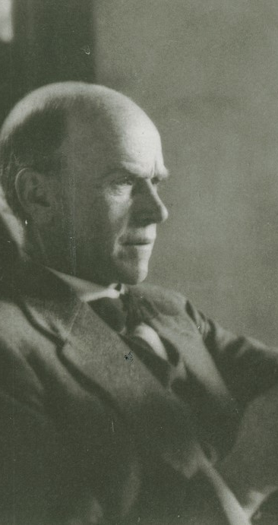
Elton Mayo & the Hawthorne Studies (1924–1932)
Studied productivity at a textile mill and concluded that boredom and lack of breaks caused high worker turnover
Examined worker productivity at the Western Electric Hawthorne plant
Poorly designed – tested the effect of light and breaks on productivity
Introduced idea that observation influences behavior (Hawthorne Effect)

Slide 10
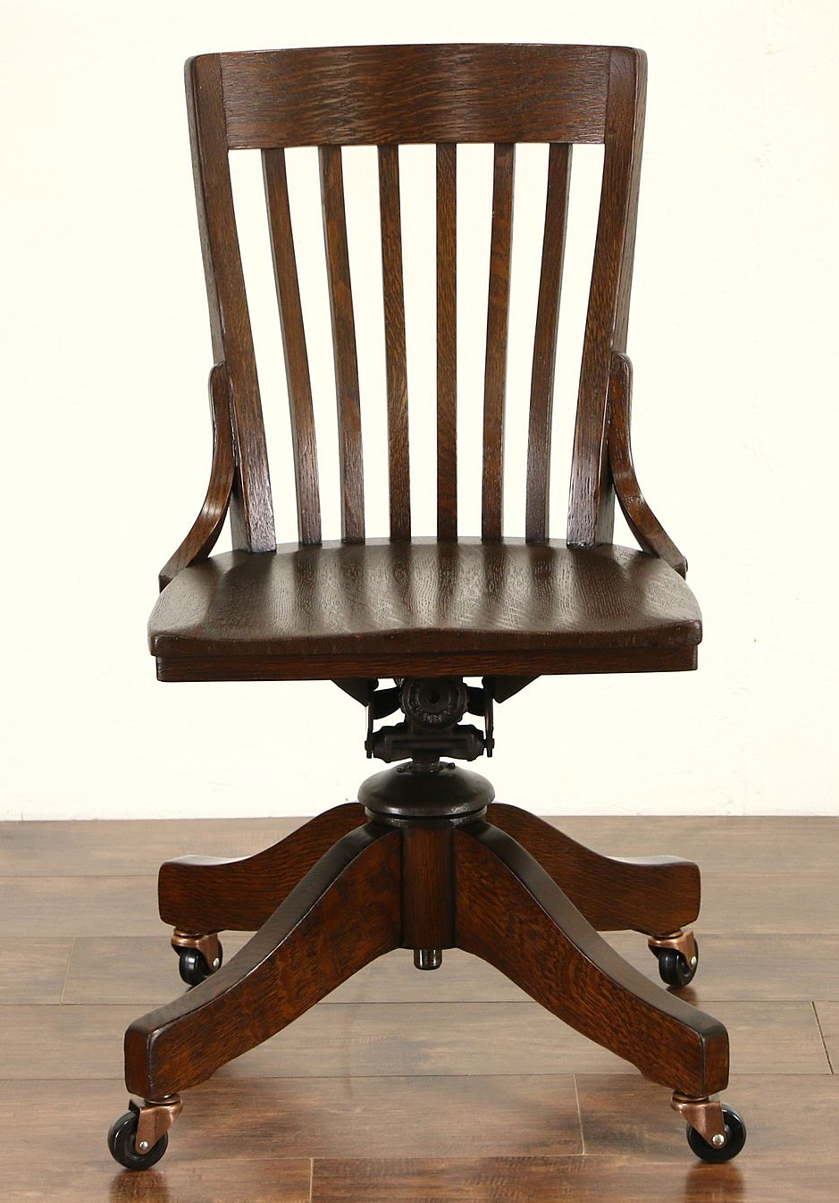
Early Anthropometry & Workshop Standardization
Measured Human Dimensions to Design Better Tools & Workstations
Recognized Value of Accommodating Human Variation
Introduced Adjustable Chairs, Desks, Tools (1910s)
Foreshadowed Modern Attention to Accessibility & Inclusivity

Slide 11
Transition to Ergonomics & Human Factors
Early Industrial Studies Influenced Later UX Research:
Systematic Observation of Users => Task Analysis in UX
Quantitative Measurement of Work => Usability Metrics (Time-on-Task, Error Rates)
Consideration of Worker Comfort => User Satisfaction & Emotional Response
From Physical Workflows to Cognitive Workflows

Slide 12
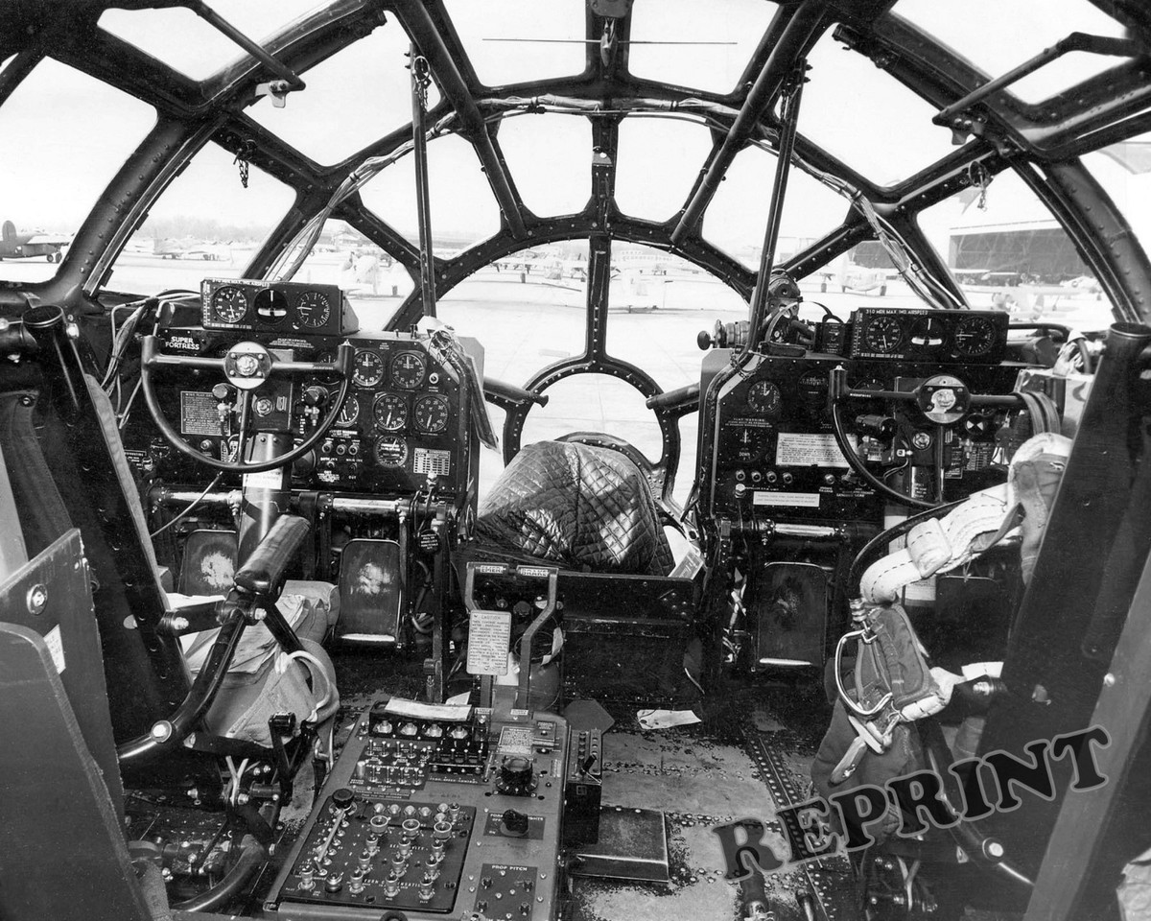
Foundations in Ergonomics & Human Factors (1940s–1960s)
Alphonse Chapanis: Early human factors research on controls
Francis Fitts: Measured pilot reaction times & motor Control
Goal: Reduce pilot error & increase operational efficiency
Focused on both layout and cognitive load
Post-War growth of ergonomics in industry including formal Human Factors labs

Slide 13
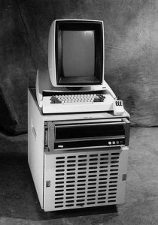
Advent of Human–Computer Interaction (1970s–1980s)
Users struggled with command-line Interfaces
Xerox PARC: Building & testing GUIs
Observations on learning curves how people develop mental models for completing tasks
The book The Psychology of HCI (Card, Moran, Newell, 1983) introduced key concepts from cognitive psychology to the field of HCI

Slide 14
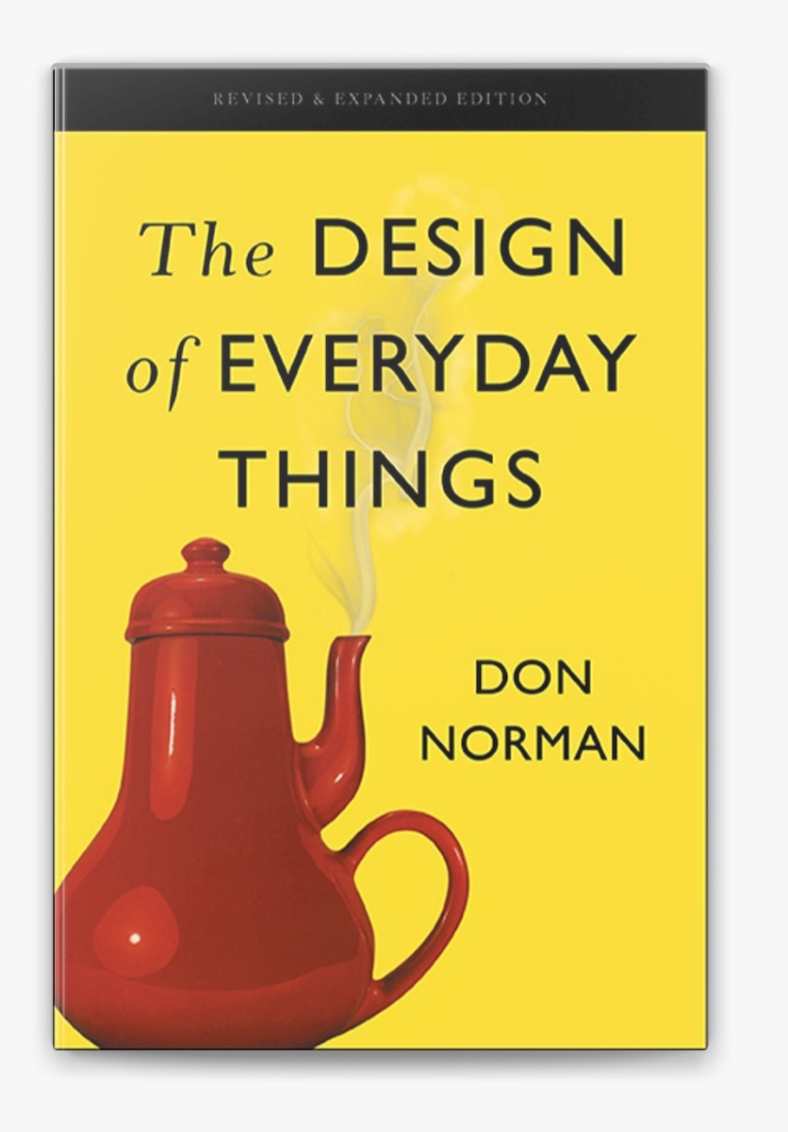
Lab-Based Usability Testing Emerges (1980s–1990s)
Dedicated Usability Labs with One-Way Mirrors
Think-Aloud Protocols (Users Verbalize Thoughts)
Task-Based Measurements: Success Rates, Time-on-Task
Don Norman Coined 'User Experience' (1993) at Apple

Slide 15

Heuristic Evaluation (Nielsen & Molich, 1990)
Usability Inspection Method Using Expert Review
Compare Design Against Usability Heuristics
Cost-Effective for Catching Major Issues Early

Slide 16
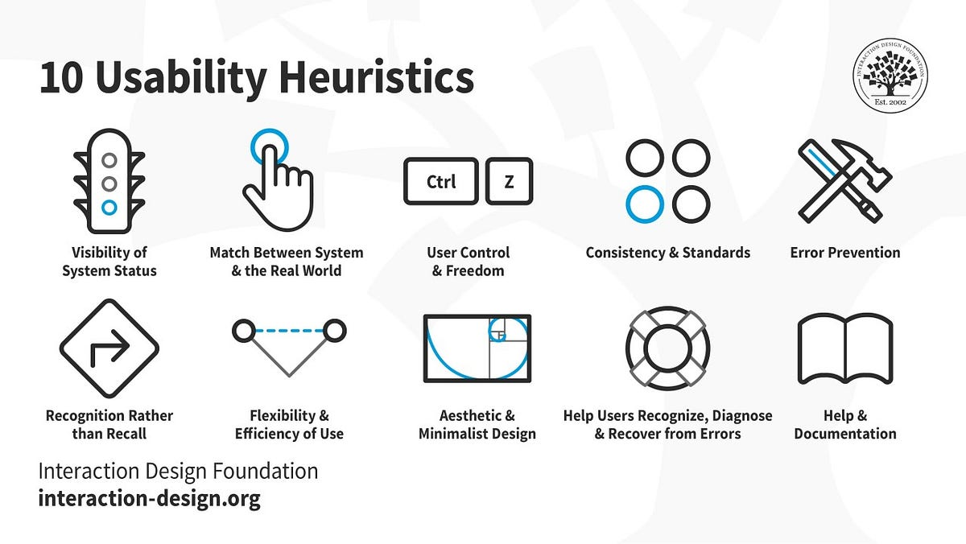

Slide 17

Widespread Commercial Software Adoption
Microsoft, IBM, Sun & others build in-house usability teams
Integrate usability into software development lifecycles
Nielsen’s web usability reports highlight common pitfalls like broken links
Lab testing & ‘guerrilla testing’ for websites
Emergence of web analytics tools

Slide 18
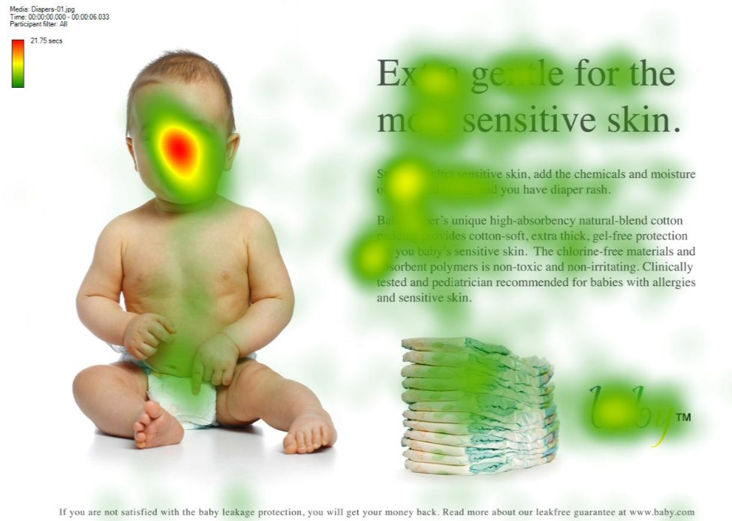
Broadening of Methods & Contextual Research (1990s–2000s)
Contextual Inquiry & Field Studies (Beyer & Holtzblatt, 1995)
Importance of testing in real-world scenarios
Card sorting, personas & scenarios as synthesis tools
Keeping teams focused on real users
Remote & unmoderated testing via online platforms
Expanding beyond geographic boundaries

Slide 19

Modern UX Research: Digital, Agile & Data-Driven
Integration into agile & lean development (Lean UX)
Behavioral analytics & big data (Mixpanel, Hotjar)
Cross-platform & multimodal research (mobile, voice, VR)
Accessibility, inclusivity & ethical considerations
Artificial intelligence

Slide 20
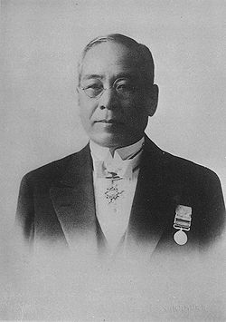
Lean/Agile Development
Rapid, iterative research in sprints
Low-fidelity prototypes & quick validations
Cross-functional teams with UX embedded early
“5 Whys”
Sakichi Toyoda

Slide 21

Norman and Cognitive Psychology
Tracking clickstreams, heatmaps & funnels at scale
Segmentation (e.g., users who abandon cart)
Complement qualitative research with quantitative insights

Slide 22

Cross-Platform & Multimodal Research
Mobile diary studies & In-Field Observations
Voice interface labs measuring speech Patterns
Mixed-reality studies with gaze & gesture tracking

Slide 23

Accessibility, Inclusivity & Ethics
Inclusive Recruitment Across Demographics & Abilities
Accessibility Testing (e.g., Screen Readers)
Data Privacy, Consent & Ethical Guidelines

Slide 24

Conclusion & Future Directions
UX Research Evolved from Factories to Digital Ecosystems
Core Principles of Observation & Measurement Remain
Future Focus: AI-Driven Research, Inclusive Practices, and Emerging Interfaces

